Slide 1
Defining time periods
How to write up the specs for your cohort and the time periods involved, so that it’s ready to code

Slide 2
Study Windows

Slide 3
Ideal Study Window
…
2012
2013
2014
2015
2016
2017
2018
2019
2020
2021
2022
2023
2024
…
Notes:
Generally speaking, the more data for a study the better. So, most researchers would in theory want the widest possible study window in order to be as inclusive as possible.

Slide 4
Study Window including limitations
…
2012
2013
2014
2015
2016
2017
2018
2019
2020
2021
2022
2023
2024
…
Who are the group or groups that you are interested in?
Notes:
However, this might not always be possible. There are often limitations that influence the cut-offs at the start and end of the study window. It's best to consider the group, or groups, you are interested in studying and how you'll define them.

Slide 5
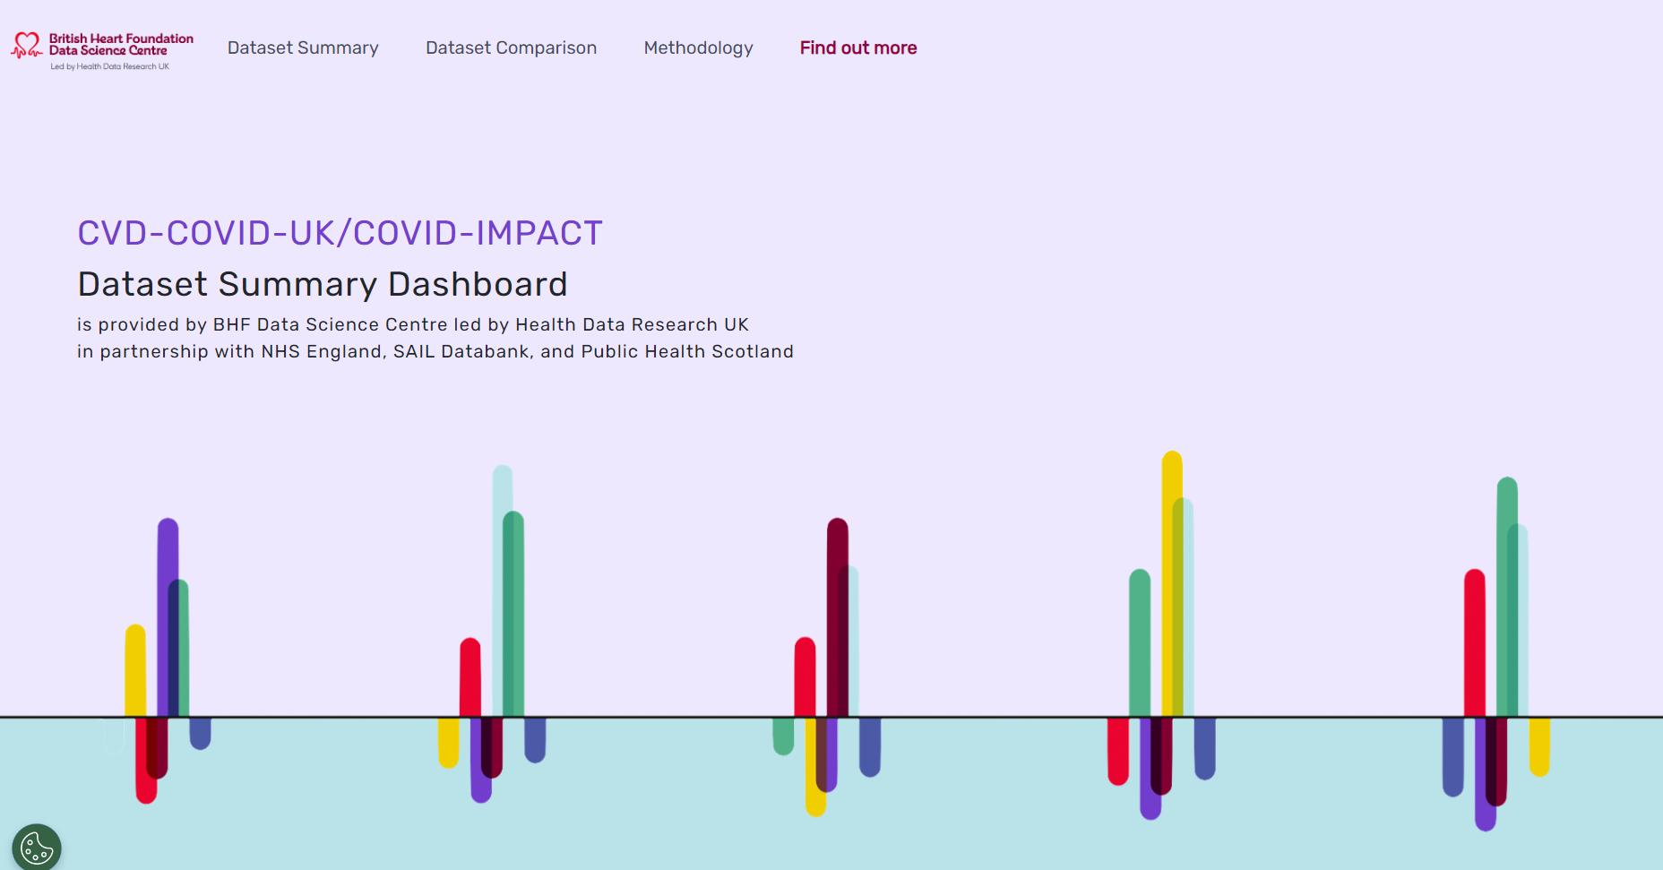
Limited by Data Availability
…
2012
2013
2014
2015
2016
2017
2018
2019
2020
2021
2022
2023
2024
…
https://bhfdatasciencecentre.org/dashboard/
Notes:
You might be interested only in patients with a history of a certain disease or healthcare event. So, to find these people you'll rely on related datasets that record the given disease or event. However, these datasets may only be available from a certain year onwards. You can start exploring this coverage using the Dataset Summary Dashboard we provide.
https://bhfdatasciencecentre.org/dashboard/

Slide 6
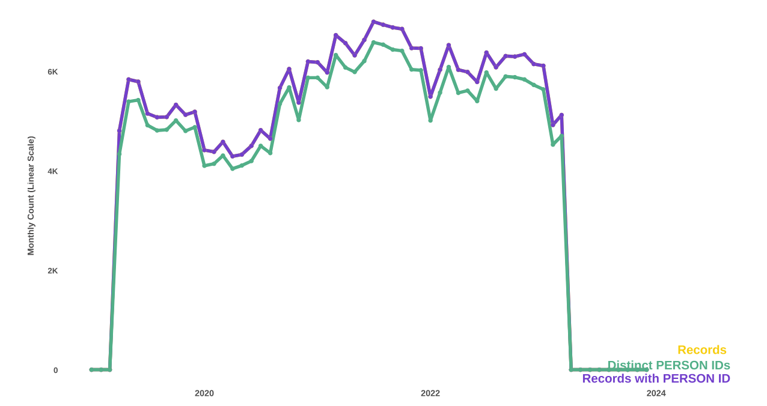
Limited by Data Availability
…
2012
2013
2014
2015
2016
2017
2018
2019
2020
2021
2022
2023
2024
…
https://bhfdatasciencecentre.org/dashboard/
Notes:
In this example, you can see that the coverage of the selected dataset only begins in 2019. Therefore, the earliest data we can use is from 2019 onwards, and so this may be the earliest cut-off for our study window. We can also see that (at the time of checking) the data was only reported up until 2024. So, even though we're at the end of 2024, there may be data from several of the most recent months that hasn't been made available yet. It's important to consider all the data (and therefore datasets) that are integral to defining your population of interest. Once you understand the limitations in the coverage of these, you'll have a clearer idea of your study window.

Slide 7
Limited by Data Availability and Coverage
…
2012
2013
2014
2015
2016
2017
2018
2019
2020
2021
2022
2023
2024
…
https://bhfdatasciencecentre.org/dashboard/
Notes:
Coverage doesn't just tell us when the data becomes available, it also indicates when the data becomes reliable. Often, some parts of the country will be quicker to adopt reporting practices than others, or guidance on reporting may change at certain points in time. Additionally, sometimes there are errors or strange quirks appearing in the data (known as artefacts).
Coverage plots are a good way to pick up on these, and for this example we can see that although the dataset is available from 2019, it only reached full coverage from 2021. Therefore, there might be a question over whether to include data from 2019 and 2020. On the one hand including them offers more data, but on the other hand there might be questions over how representative those years are. Do the patients/event covered in those give a fair impression of those that were not.
This is an important consideration in defining your study window and may well be something to scrutinise or adjust for, and importantly reflect in your published findings.

Slide 8
Limited by external interventions
Covid
…
2012
2013
2014
2015
2016
2017
2018
2019
2020
2021
2022
2023
2024
…
Notes:
Other things may also play a part in defining your study window. External interventions may mean that, although datasets may have an earlier start date, the healthcare ecosystem changes from a certain point. Thus, if the group, or events, you are studying depend on this, you might be similarly limited by it.
An easy example would be COVID-19 diagnoses. Record keeping of infectious diseases might date back decades, but if the COVID-19 variant you are interested in was first diagnosed in the UK in 2020, then this timepoint will be the earliest at which you can usefully use data. Hence, your study window start date will be limited by this.

Slide 9
Limited by external interventions
Covid
…
2012
2013
2014
2015
2016
2017
2018
2019
2020
2021
2022
2023
2024
…
Lockdown
…
2012
2013
2014
2015
2016
2017
2018
2019
2020
2021
2022
2023
2024
…
Notes:
Likewise, you may be interested in behaviour and health system changes resulting from the pandemic, in which the first lockdown might be a more relevant limitation to you. This occurred in late March 2020.

Slide 10
Limited by external interventions
Covid
…
2012
2013
2014
2015
2016
2017
2018
2019
2020
2021
2022
2023
2024
…
Lockdown
…
2012
2013
2014
2015
2016
2017
2018
2019
2020
2021
2022
2023
2024
…
Vaccine
…
2012
2013
2014
2015
2016
2017
2018
2019
2020
2021
2022
2023
2024
…
Notes:
Or you may be considering the introduction of the vaccine as part of your study. This occurred at the end of 2020.

Slide 11
Observation periods
Notes:
The study window is shaped by a) who you want to observe, and b) what you want to observe about them. Once you have decided who, you may need to consider further decisions about the observation period i.e., the period of time you'll collect those observations.

Slide 12

Universal milestone vs individual
Lockdown
…
2012
2013
2014
2015
2016
2017
2018
2019
2020
2021
2022
2023
2024
Present
Vaccine
…
2012
2013
2014
2015
2016
2017
2018
2019
2020
2021
2022
2023
2024
Present
Notes:
In this case let's consider two interventions: lockdowns and vaccines.
Lockdowns applied to pretty much everyone (notable exceptions would be keyworkers, or individuals in different geographical areas in later lockdowns). Therefore, these milestones (start and end) would be universal, and you'd have the same observation period for everyone.
However, the vaccine was rolled out in stages and thus different people received their first dose at different times. So, if you were following people up until present day (or the most recent available data), and gathering observations, you would be introducing bias; certain individuals would have a longer follow-up time, and thus more time for adverse events to occur.
So, If you are defining your study population based on when they received a diagnosis or a treatment, and intending to follow them beyond this, you'll need to find a way to make sure your follow-up period doesn't distort your findings.

Slide 13
Observation Periods
Vaccine
…
2012
2013
2014
2015
2016
2017
2018
2019
2020
2021
2022
2023
2024
Present
Notes:
One option is to decide to only observe people for a given amount of time. Let's say it's 3.5 years.

Slide 14
Observation Periods
Vaccine
…
2012
2013
2014
2015
2016
2017
2018
2019
2020
2021
2022
2023
2024
Present
Notes:
This would level the playing field. However, you might find that you are cutting off some individuals even when they had a longer duration of follow-up available.

Slide 15
Observation Periods
Vaccine
…
2012
2013
2014
2015
2016
2017
2018
2019
2020
2021
2022
2023
2024
Present
Notes:
Likewise, you might find you have to exclude some individuals from your study altogether, because the event occurred too recently for them, and they simply don't have enough follow-up to qualify.

Slide 16
Observation Periods: Follow up
Vaccine
…
2012
2013
2014
2015
2016
2017
2018
2019
2020
2021
2022
2023
2024
Present
Notes:
In deciding the follow-up period there may be a balancing act. The shorter the period, the more individuals you can include, but the less you time you have to observe them. The longer the period, the fewer individuals you can include, but the more you can observe. This can be informed by some scoping of the data to understand the potential size of the population, and with clinical knowledge of how long anticipated follow-up events typically take to materialise.
Another consideration may be seasonality. Healthcare systems often experience seasonal pressures, and some events are more common based on this. This means if you follow people for an uneven number of years after they experience an event or intervention (e.g., 2.5 years), some individuals will be observed for 2 winters, and others 3. It's often best to follow-up for a whole number of years if you aren't constrained by other limitations.
In certain cases, you may be so restricted that you choose not to define a strict follow-up period (of X years or Y months) and instead simply not follow-up and adjust or stratify by it.

Slide 17
Observation Periods: Lookback
Vaccine
…
2012
2013
2014
2015
2016
2017
2018
2019
2020
2021
2022
2023
2024
Present
Notes:
It's also worth noting that some studies are not interested in observing what happens after an event (which we referred to as a follow-up period). Some studies will be more concerned with what happened preceding an event. A similar principle will apply; however, it is more likely to affect the study window start date, rather than the study window end date.

Slide 18
Individual milestones: Start & End
Vaccine outcome in teen years
…
2012
2013
2014
2015
2016
2017
2018
2019
2020
2021
2022
2023
2024
Present
Notes:
Some studies may in fact have an individual milestone that affects both the start and end date. For example, if you were studying vaccine effects in teenage years. In this example, individuals may receive their vaccine at different ages, and so there would be different follow-up periods available before they 'age-out' of being a teenager.
For someone vaccinated at 18 years old you may only have a year or two of follow-up, vs. someone vaccinated at 13 years old where you'd have several years of follow-up. A third individual may be vaccinated at 13 years old as well, but this may have happened so recently that they only have a year of follow-up available. In this situation you may want to allow follow-up periods to vary, but then account for this later on by adjusting or stratifying in your analysis as previously mentioned. It is prudent to have a minimum eligibility e.g., 'must have at least 1 year of follow up available' - otherwise you'll have individuals in the study where very little observation is possible.

Slide 19
Variable states

Slide 20
Perpetual State vs State Change
Death
…
2012
2013
2014
2015
2016
2017
2018
2019
2020
2021
2022
2023
2024
Present
Notes:
Often, we define our study population based on an individual’s history or characteristic. But its worth being aware of whether these variables are changeable. Here, we'll refer to this as the 'state' of the variable.
In the above slide you can see that the variable 'death' is an example of this. The characteristic of alive vs. dead for this individual changes in 2022. So, with this record of death, we know that for all the years preceding they were alive, and all the years after they are dead. Seems like a strange comment to make but it is useful as a contrast.

Slide 21
Perpetual State vs State Change
Death
…
2012
2013
2014
2015
2016
2017
2018
2019
2020
2021
2022
2023
2024
Present
Ethnicity
…
2012
2013
2014
2015
2016
2017
2018
2019
2020
2021
2022
2023
2024
Present
Notes:
We can then contrast it to the variable of ethnicity. This is something that does not change, thus the characteristic is a perpetual state. A record in 2022 indicates an individual's ethnicity, and we may assume this to 'always have been the case' and 'always be the case'.

Slide 22
Perpetual State vs State Change
Death
…
2012
2013
2014
2015
2016
2017
2018
2019
2020
2021
2022
2023
2024
Present
Ethnicity
…
2012
2013
2014
2015
2016
2017
2018
2019
2020
2021
2022
2023
2024
Present
Ethnicity records
…
2012
2013
2014
2015
2016
2017
2018
2019
2020
2021
2022
2023
2024
Present
Notes:
However, something we often see in the data is that the variable does vary over time or in different datasets. A primary care record may disagree with a secondary care record, or it may even go back and forth several times. The state of the variable should be perpetual, but the recording is inconsistent. Ethnicity is a commonly used variable in studies, and, as such, many other researchers have considered the question of which record to use. It is particularly tricky as some categories of ethnicity don't perfectly map on to each other in their descriptions, and sometimes it is nested e.g., a subgroup of a broader ethnicity.
For these kind of variables, we often have an asset that will provide the best composite source for you to use, or sometimes, where studies prioritise different methods of compiling, we'll provide an algorithm so you can pick the method most suitable to you and you can compile it yourself.
This is all important because if you are defining your cohort based on a characteristic such as this, you may need to make decisions on how the characteristic itself (or the variables holding the record of it) are defined.

Slide 23
One-off vs Recurring
Death
…
2012
2013
2014
2015
2016
2017
2018
2019
2020
2021
2022
2023
2024
Present
Pregnancy
…
2012
2013
2014
2015
2016
2017
2018
2019
2020
2021
2022
2023
2024
Present
Notes:
In characteristics that can change, we can make the distinction between 'one off' and 'recurring'.
Death can be described as 'one off', whereas pregnancy could be described as 'recurring’ (for mother’s who have multiple children). This matters as well in defining your study population. For example, in the case of pregnancy, you may need to decide which pregnancy to include. Including each incidence would mean clustering in your data and bias.
Of course, pregnancy is more of a period rather than a single point in time. So, if, based on other constraints, your study period ends in mid 2021, do you include a pregnancy that starts before that cut-off, but ends after it? To be able to curate your data, you'll need to make these specific decisions so that the curation code can reflect it.
These might feel like niche situations, but they actually come up fairly often. Defining a study population as having a 'history of heart disease' would be analogous to the one-off characteristic. You may have several cardiac events but after your first one, you then always have 'a history' of it. Likewise, anything involving hospitalisation is sometimes more of a 'period' than a single point in time, so it requires similar consideration to to the pregnancy situation. Many events have the potential to be recurring, so decisions as to which event to include do need to be made. For this, often studies will either consider only 'the first occurring', or 'first occurring in study window', or simply aggregate it to 'any example' or 'count of events'.

